Slide 1
ADO.net
A Simple Introduction

Slide 2
What is ADO.net?
First the word ADO stands for ActiveX Data Objects
And it is an integral part of .Net Framework of Microsoft hence the .net after ADO.
It allows you to access Relational Databases (e.g. MySQL, Oracle, MSSQL, MS Access) or XML and manipulates data according to your own needs.
It has two modes of accessing data, namely, 1) the connected model and 2) the disconnected mode

Slide 3
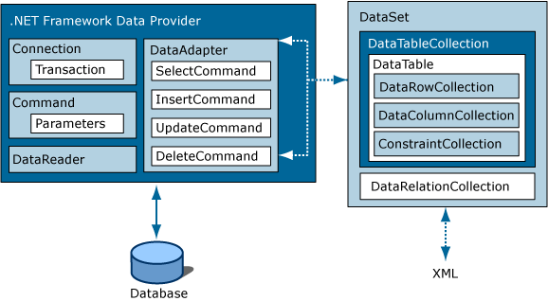
The ADO.Net Architecture

Slide 4
Connecting to a Database
In order for you to access data (or a database for that matter) you need a connection to that data store.
Connection
Database

Slide 5
Data Providers
There are four Data Providers that ADO.net framework provides in order for you to access a variety of databases or data sources.
  System.Data.SqlClient – for MS SQL
  System.Data.OleDb – for accessing Non-MSSQL database like MySQL, MS Access and also for XML
  System.Data.Odbc – for accessing Non-MSSQL database like MySQL, MS Access and also but you have to set-up an ODBC connector first.
  System.Data.OracleClient – for Oracle Database

Slide 6
Dataset
It is an in-memory or memory resident representation of your database.
It is disconnected from your database so any changes will not affect the database not until you port it back to the database using the Data Adapter as you will see later on.
Dataset contains DataTable and DataTable contains DataRow and DataRow contains DataColumns (remember the Hierarchy of Data, namely, Database->Table->Record/Row->Field/Column)

Slide 7
Data Adapter
It is you actual connection to your Database or it provides link to your database in a connected state as opposed to disconnected mode in Dataset.
It therefore by the ways Fills your Dataset (and subsequently your DataTable) with Data from your Database.
This is where you can make Add, Delete and Update record(s) from your database.

Slide 8
DataReader
Allows you to access data from database in a sequential or forward-only manner. If you want to access a subset of your database like a Table or just simply records from your database and would like to traverse quickly on it then use DataReader.

Slide 9
Command
Allows you to perform SQL-commands or operations to your Database. You could either just simply use SELECT or if you want to make changes to your Database you could use INSERT, UPDATE and DELETE.

Slide 10
Command and Parameters
Sometimes when you want to query your Database you want to make a criteria for example if you have Employees table and you want only to query Employees that are of Male gender then you have to qualify your SQL command for example with SELECT * FROM Employees WHERE Gender=‘M’ . The WHERE part is where you could put your Parameter like SELECT * FROM Employees WHERE Gender=@Gender

